Slide 1
Autodesk Exchange Store:
Copy protection using Entitlement API
Notes:
Welcome to this session. In this session, we will going to talk about Entitlement API in Autodesk Exchange apps.

Slide 2
Agenda
What is Entitlement API?
How Entitlement API works
Demo’s
AutoCAD
.NET
ObjectARX
Lisp
Revit
Inventor
Resources
Notes:
Agenda..

Slide 3
Entitlement API
Simple copy protection system
REST API implementation
Copy protection entirely in your App (add-in).
Products supported
AutoCAD & its Verticals - 2016/2015/2014
Revit 2016
Inventor 2016
Notes:
This is your simplest option for handling copy protection to your Apps, and is your only option if you want to handle protection entirely in your (add-in) App and not have to create your own webserver.
Your App will make a simple HTTP (REST) call to the Entitlement API, passing in the unique ID of your App, and the unique Id of the customer currently signed in to their Autodesk Id from the Autodesk product in which your add-in is running. The Entitlement API response will tell you whether the user has an ‘entitlement’ to use your App (I.e whether that user has purchased your App).
You can use the Entitlement API in your subscription Apps too. In subscription Apps, the result returned depends on whether the user’s subscription has expired or not. (i.e., this API will respond that the user has an entitlement for the App only while the subscription is valid).
At present, you can use this method to product
AutoCAD & its Verticals - 2016/2015/2014
Revit 2016
Inventor 2016

Slide 4
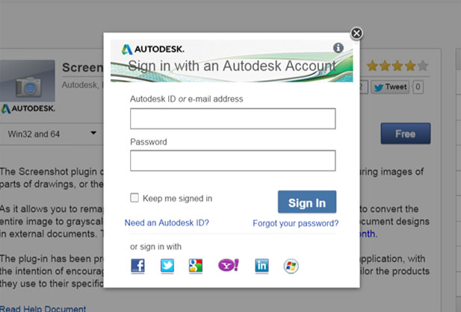
How Entitlement API works - 1
To download any App, User needs to sign-in to Exchange Store.
Exchange Store maintains the downloaded users list for every App.
Entitlement API uses this list.
Notes:
To download any App from Exchange store users needs to sign-in to Exchange store using an Autodesk
This (signing by users) allows Autodesk Exchange store to maintain a list of users who have downloaded the App from the store. The Entitlement API makes use of this list to tell you whether the user has an ‘entitlement’ to use your App or not.

Slide 5
How Entitlement API works - 2
Call Checkentitlement
Autodesk user id (internal Autodesk id)
AutoCAD (& verticals) - “ONLINEUSERID” (system variable)
Revit - Application.LoginUserId API
Inventor – AdGetUserId API (unmanaged API)
App id
Unique id of the App in Exchange Store
Email appsubmissions@autodesk.com to get the app id of your App.
Example id: appstore.exchange.autodesk.com:screenshot
Notes:
Entitlement API need below information
User ID
App ID
Please note that, this user id is not the AutodeskID which is used to login Autodesk Exchanges website or Autodesk 360 from products. It is actually an internal ID which is saved in Autodesk Authentication server.
App ID can be obtained once you submit the App in the Exchange store. This ID will remain the same for the life of your App in the Exchange store.

Slide 6
Demo
AutoCAD
.NET
ObjectARX
Lisp
Revit
Inventor

Slide 7
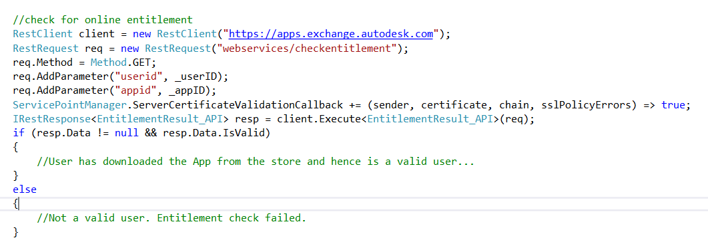
NET code snippet with RestSharp
Notes:
//check for online entitlement
RestClient client = new RestClient("https://apps.exchange.autodesk.com");
RestRequest req = new RestRequest("webservices/checkentitlement");
req.Method = Method.GET;
req.AddParameter("userid", _userID);
req.AddParameter("appid", _appID);
ServicePointManager.ServerCertificateValidationCallback += (sender, certificate, chain, sslPolicyErrors) => true;
IRestResponse<EntitlementResult_API> resp = client.Execute<EntitlementResult_API>(req);
if (resp.Data != null && resp.Data.IsValid)
{
//User has downloaded the App from the store and hence is a valid user...
}
else
{
//Not a valid user. Entitlement check failed.
}
RestSharp : http://restsharp.org/

Slide 8
Resources
Entitlement API for desktop Apps @ http://usa.autodesk.com/adsk/servlet/item?siteID=123112&id=24243865
Implementing copy protection in your Apps @ http://usa.autodesk.com/adsk/servlet/item?siteID=123112&id=24243607
Email to appsubmissions@autodesk.com

